Slide 1
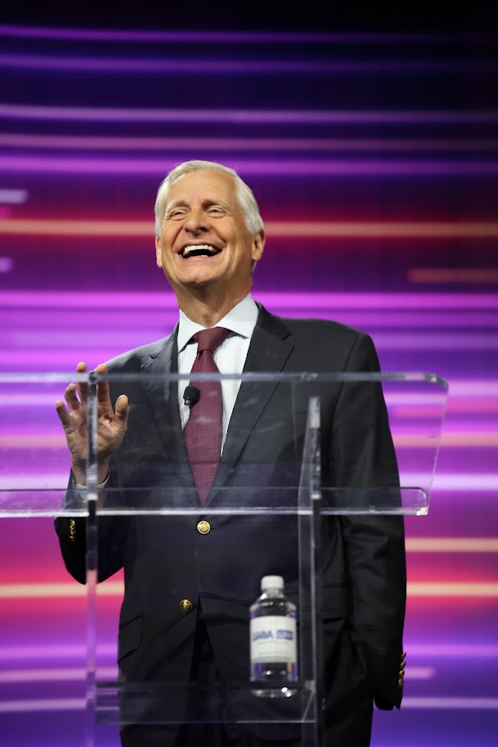
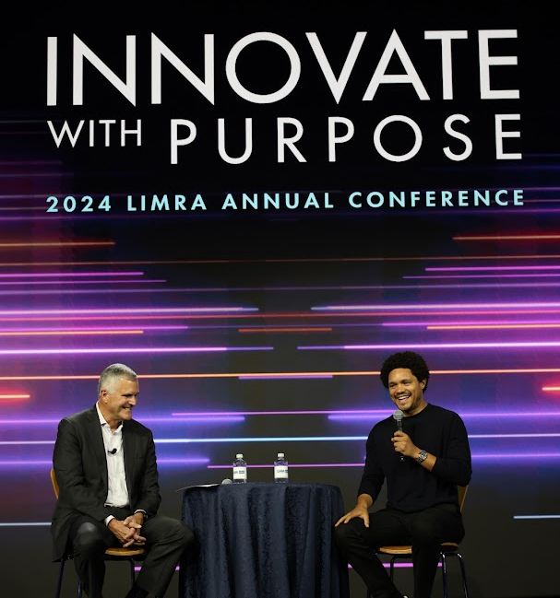
2024 LIMRA Annual Conference – Innovate With Purpose
The highest attendance since 1979 with 1,023 registered to attend in person and 480 virtually
Representatives from 18 countries in attendance
26 captivating breakout sessions facilitated by leaders in the life, annuity, and workplace benefit industries
Key topic areas – digital transformation, distribution dynamics, talent strategies, and customer experience
Main Stage Presenters and Special Guests:
Trevor Noah, Emmy Award-Winning Comedian & Bestselling Author
Carla Harris, Senior Client Advisor, Morgan Stanley
Ashley McBryde, Grammy Award Winner
Jon Meacham, Presidential Historian; Pulitzer Prize-Winning Author
SAVE THE DATE
2025 LIMRA Annual Conference
Sept. 14-16, 2024
Gaylord Palms
Kissimmee, FL

