Slide 1
2024 Life Insurance Barometer
The Generational Shift Has Arrived

Slide 2
2024 Insurance Barometer
The Insurance Barometer Study
A Fourteen-Year Partnership
Read the full report.
Notes:
Most here familiar with LIMRA and our 100+ year history serving the life insurance industry, but maybe some of you are not as familiar with our partner for the Barometer Study, Life Happens
Life Happens is the only nonprofit in the industry to educate consumers about life insurance and related products AND to help companies do the same. (It’s important to mention Life Happens as they’ve help defray the cost since the beginning and this is a partner study.
2024 marks the fourteenth year of the study in partnership with Life Happens
As a “barometer,” the study seeks to measure and trend the perceptions, attitudes, and behaviors of adult American consumers with a focus on life insurance
All data are from consumers, not insurance companies
This year, our sample size was around 5,000
Respondents include retired and unemployed adults.
Report published two reports this year; far more than we’ll discuss here today.
Barometer seeks to trend topics as we have recurring themes, but also usually include deeper dives on different markets. Black, Hispanic, Single mothers, middle income, and this year, LGBTQ+

Slide 3
The Path Forward for Life Insurers
Addressing the Life Insurance Need Gap
Demographic Segments and Life Insurance
Barriers to Purchase
Reaching New Consumers
Combination Life & LTC Products & Wellness

Slide 4
Addressing the Life Insurance Need Gap
Notes:
Mention a bit about market environment – record premium and increase in policy count. Inflation, cost of living, later families, etc. Post pandemic, amercians still reporting an elevated need for life insurance:
In 2023, the total new annualized premium for US life insurance saw a modest increase of 1% from the previous year, reaching a record $15.6 billion. this marks the third consecutive year of record-setting growth in new annualized premium.
The fourth quarter of 2023 alone witnessed a 4% increase in total life insurance premium to $4.2 billion, with policy sales up by 2%, largely fueled by term life insurance’s strong performance.
sales increases reported by a majority of companies, including half of the top 10 carriers.
In 2023, policy count increased 4
consumer sentiment data suggests that more people started feeling more confident in the economy and their own financial outlook in 2024. This may have prompted consumers to address their life insurance needs.

Slide 5
People Still Recognize the Need
Un-insured and under-insured need-gap:
30%
Need life insurance
11%
Plus
Need more life insurance
Source: 2024 Insurance Barometer Study, LIMRA and Life Happens.
*Owner + non-owners may not equal total due to rounding.
Notes:
The life insurance need gap is a simple calculation to gauge Americans’ state need for life insurance.
We look at those without life ins who say they need and those who have some type of life and say they need more of it.
In 2024
30% of Americans are uninsured and report the need for it. 11% do have some life ins but report they need more.

Slide 6
People Still Recognize the Need
Un-insured and under-insured need-gap:
75
Million Americans
27
Plus
Million Americans
Source: 2024 Insurance Barometer Study, LIMRA and Life Happens.
Notes:
In terms of population numbers… (transitions to next slide)

Slide 7
The Life Insurance Need-Gap
42%
102
of Americans live with a life insurance need-gap
million adult customers
Source: 2024 Insurance Barometer Study, LIMRA and Life Happens.
Notes:
Looking at these calculations over many years allows us to see some trending.

Slide 8
Need-Gap Over Time
Source: 2024 Insurance Barometer Study, LIMRA and Life Happens.
Notes:
Always below 40% until the pandemic, then elevated, but still elevated even as pandemic is past. Long covid tail, people know people who were affected without life insurance. Can no longer attribute this elevated need to pandemic though. Another factor is that many “need” but don’t have the income in face of COL and inflation and/or delayed marriage/family dynamics.
One reason ppl may express need is to gain some peace of mind /security

Slide 9
Perceived Security for Middle Income Households
60%
Of life insurance owners say they feel financially secure
50%
vs.
Of Non-Owners
Source: 2024 Insurance Barometer Study, LIMRA and Life Happens.
Notes:
Mid income is 50-150K/year households. Removed wealthier households b/c many feel financially secure regardless of having life or not. Always good here to add a personal story or anecdote about feeling secure with a comprehensive policy and plan. We all agree life insurance is a great product for most Americans. But there are not just barriers, but some misconceptions and perceptions to battle

Slide 10
Perceptions
% who agree with these statements
 | Gen Z | Millennial | Gen X
Life insurance is only for final expenses | 30% | 28% | 21%
I can't personally benefit from life insurance | 27% | 29% | 28%
Certain types of life insurance provide the benefit of some guaranteed income in retirement | 46% | 54% | 51%
Life insurance companies prefer I live a long and healthy life | 49% | 63% | 61%
Source: 2024 Insurance Barometer Study, LIMRA and Life Happens.
Notes:
The first 3 are “misconceptions” last one is a perception . I love talking about the last one, as hypothetically it should be 100%. Guaranteed income/cash value is a good talking point too.
Fair to make the point that final expense policies ARE the right fit for many and that’s fine.

Slide 11
Life Insurance Ownership
Total life insurance ownership: 51%
Source: 2024 Insurance Barometer Study, LIMRA and Life Happens.
Notes:
There’s no smooth transition to this, but everyone wants to see this.
Make it very clear this is from consumer data. Highlight the gender gap (upcoming slide) and maybe Hispanics – who dropped more than anyone during pandemic and haven’t’ recovered as much as other race/ethnicities. Challenge audience on that if it makes sense.

Slide 12
Demographic Insights and Life Insurance

Slide 13
Gender Ownership Gap
Fewer women than men own life insurance:
46%
57%
vs.
Women
Men
Source: 2024 Insurance Barometer Study, LIMRA and Life Happens.
Notes:
Challenge to audience – this gap has always existed and exists across several demographic levels (Full time workers, income strata, races, with dependent children, etc.)

Slide 14
Bridging The Gender Gap
Empowering Women Through Life Insurance
54
Million
The overall need for life insurance is higher among women than among men.
The 11-point
ownership gender gap equals the largest reported over the 14-year history of the Barometer Study.
Women say they need (or need more) life insurance.
45%
vs.
39%
Source: 2024 Insurance Barometer Study, LIMRA and Life Happens.
Notes:
This offers a good time to stop and discuss if audience is right for that. Historic artifact? Gender roles? What is it? Is it the same in every country? What can we do to reach more women, esp decision making women and single mothers, et.c

Slide 15
Who Needs it Most?
56%
53%
49%
45%
Younger
Generations
(Ages 18 to 59)
Households earning under $50,000 per year
Hispanic Americans
Black Americans
Women
49%
46%
45%
Gen Z
Millennials
Gen X
Source: 2024 Insurance Barometer Study, LIMRA and Life Happens.
Notes:
Concerning that X is same as Mill and not far off of Gen Z, reiterate Hispanics losing ownership #’s during pandemic.
For right audience (honestly not many) can explore lower incomes and their need. Of course they have a need, we all do, but what can the industry do better to serve them?

Slide 16
A Generational Shift is Underway
In 2022, Gen X was “most concerned” about financial issues¹.
For the second consecutive year, Millennials Expressed the highest overall financial concern (36%)².
1 On 14 of the 15 specific financial matters in this study.
2 On 9 of the 15 specific financial matters in this study.
Source: 2024 Insurance Barometer Study, LIMRA and Life Happens.
Notes:
In other words, X’ers seem to be (should be) getting their act together approaching retirement, and Mill’s startingto see the writing on the wall. Esp these days where rent/mortgage//interest is so dang high and wages have not risen commensurately.

Slide 17
Top Financial Concern by Generation
Having Enough Money for a Comfortable Retirement (2024)
Having Enough Money for a Comfortable Retirement (2022)
54%
Millennials
50%
48%
Gen X
52%
29%
Baby Boomers
29%
44%
Total
43%
Source: 2024 Insurance Barometer Study, LIMRA and Life Happens.
Notes:
More about the shift. Boomers consistent as they are largely retired. X’ers lessened but still concerningly elevated; nearly as much sa younger millennials.

Slide 18
Financial Concerns Are High Among Younger Generations
Source: 2024 Insurance Barometer Study, LIMRA and Life Happens.
Notes:
I’d gloss over the retirement here and focus on the 3 “insurances” in the middle. In other words, these are their concerns and here are some life products that can help with that. (You can throw annuities in there too if it makes sense to do so of course.)
Transition is something like “the baro historically has been a generational study, but it also has focused on margianalized group and different demographics like Black Americans, Hispanic Americans, single mothers, Hispanic americans, and this year -- >

Slide 19
The LGBTQ+ Community & Life Insurance
46%
Of LGBTQ+ adults say they need life insurance – or more of it.
Lower Ownership Rate: 40%
Higher Recognized Need: 46%
Source: 2024 Insurance Barometer Study, LIMRA and Life Happens.
Notes:
.
(there are also reasons for this: less marriage, fewer with children

Slide 20
The LGBTQ+ Community & Life Insurance
46%
8
of LGBTQ adults live with a life insurance need-gap
Lower Ownership
Rate: 40%
Higher Recognized
Need: 46%
million adult customers
Source: 2024 Insurance Barometer Study, LIMRA and Life Happens.

Slide 21
LGBTQ+ Financial Concerns
Source: 2024 Insurance Barometer Study, LIMRA and Life Happens.
Notes:
LGBTQ skew young, so it’s germane to compare them to the younger gens.

Slide 22
A Matter of Trust?
Source: 2024 Insurance Barometer Study, LIMRA and Life Happens.
Notes:
This is dicey. This is NOT discrimination! They do NOT feel discriminated against as you see at left. This is a matter of trust. Which ISN’T that bad with 15% or less feeling mistrustful, but it is something to acknowledge. Why do they feel this ay more than other historically marginalized groups (Black, young, Hispanics). Unconscious bias? Worse? Assuming thi shappens in conversations about beneficiaries and family dynamics and the feeling about “what happens now”

Slide 23
Barriers to Purchase

Slide 24
Primary Reasons For Not Owning (More) Life Insurance
Perceived Cost
Not sure what type or how much to get
No one has approached me about it
48%
25%
13%
Other Financial Priorities
Procrastination
36%
22%
Source: 2024 Insurance Barometer Study, LIMRA and Life Happens.
Notes:
Education education education

Slide 25
Understanding the True Cost of Ownership
52%
78%
54%
Cited that life insurance is “too expensive” as their perceived reason for not having coverage (or more of it).
Overestimate
the cost of
life insurance.
Based their life insurance cost estimate on
“gut instinct” or a “wild guess”.
Source: 2024 Insurance Barometer Study, LIMRA and Life Happens.
Notes:
Policy asked about was a $200K 20 yr term for healthy male.

Slide 26
Reaching New Consumers

Slide 27
Reaching People Where They Are
59%
Use social media when seeking information on financial or insurance products.
Source: 2024 Insurance Barometer Study, LIMRA and Life Happens.

Slide 28
Personalize Content to Educate and Inform
Importance of Social Media Attributes
64%
52%
49%
46%
Reliable information on financial or insurance products
Recommendations from friends and family on their social media
Keeping in touch with my financial professional
Reading other people’s reviews/comments
*Percent saying “extremely” or “very” important.
Source: 2024 Insurance Barometer Study, LIMRA and Life Happens.

Slide 29
Influencer Data
43%
Find it very or extremely important to get recommendations from experts, influencers or spokespeople when researching a financial or insurance product on social media.
Source: 2024 Insurance Barometer Study, LIMRA and Life Happens.

Slide 30
Combination Life + LTC Products and Wellness

Slide 31
Combination Life and LTC Products
28%
Say they are very or extremely likely to buy a combination life insurance + long-term care policy.
Source: 2024 Insurance Barometer Study, LIMRA and Life Happens.

Slide 32
Wearable, Shareable, Incentivized
Source: 2024 Insurance Barometer Study, LIMRA and Life Happens.
Notes:
Vitality (that’s a TM/brand name, so use depending on audience) but incentive programs, not new, tried over and over in health insurance… but wearables are so prevalent now and people are more apt to share data w trust companies, we all do it every day. Give them financial incentives? Looking good in 2024. Need to explain it’s not just for the healthy.
Less than 2/3 of Americans think life insurers want them to live long and healthy lives. That coud be a marketing push; explaining they would prefer you don’t pass away young. … in a marketing way of course.

Slide 33
What We Can Do
Focus on education and awareness
Incentives with wellness programs
Acknowledge the different needs of demographic groups to build trust
Work cohesively to bridge the ownership and need gaps
Source: 2024 Insurance Barometer Study, LIMRA and Life Happens.

Slide 34
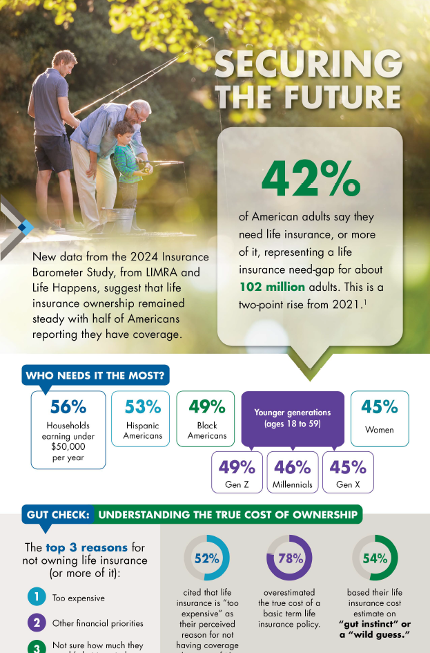
Series Infographic
2024 Insurance Barometer Study
Insurance Barometer Series

Slide 35
Future Reports
Report 2: Reaching New Life Insurance Buyers: What Works?
2024 Insurance Barometer Technical Supplement

Slide 36
Empowering Our Members
Advancing the
financial services industry
by empowering our members with:
KNOWLEDGE
INSIGHTS
CONNECTIONS
SOLUTIONS

