Slide 1
Financial Professional and Wholesaler Perspectives
Kelly Fehring • Member Relations Director
June 10th, 2024
Notes:
Congratulations to another impressive quarter #4 with a 35%+ increase over 1^{st quarter last year!}

Slide 2
Key Themes
Wholesalers are impactful
In-person communication is most valued
The industry is embracing data analytics, which drives more daily activities
The Art and Science of Wholesaling, © 2024 LL Global, Inc.

Slide 3
Value of the Wholesaler
72%
of financial professionals agree – a good relationship with a wholesaler is often the determining factor when selecting a carrier to place business with
Source: 2023 US Financial Professional Survey

Slide 4
Wholesaler Interactions
Financial professionals usually work with:
3 - 4
5 - 6
2 -3
Interactions with wholesaler before business is placed
Carrier internals
Carrier externals
Source: 2024 Insurance Barometer Study, LIMRA and Life Happens.

Slide 5
Wholesaler Top Services: Financial Professional Perspective
Top Most Impactful Service
Source: 2023 US Financial Professional Survey

Slide 6
Financial Professional Interaction with Wholesaler
Source: 2023 US Financial Professional Survey

Slide 7
Most Highly Valued Means of Wholesaling
What means of wholesaling will be most highly valued by you in the next 3 years?
Source: 2023 US Financial Professional Survey

Slide 8
Annuity Externals: Effectiveness of Virtual
Rank the effectiveness of virtual communication for:
Source: The Art and Science of Wholesaling, © 2024 LL Global, Inc.

Slide 9
External Wholesaler vs. Hybrid Wholesaler
Prefer working with a traditional external wholesaler
Source: 2023 US Financial Professional Survey
Notes:
Better product knowledge.
The fewer product service offerings they work with the deeper their knowledge is of their products.
They have a better feel for what’s going on in my world.
Many comments about: better relationships and support when in-person interaction occurs.

Slide 10
Data Analytics Have A Positive Impact
Source: The Art and Science of Wholesaling, © 2024 LL Global, Inc.

Slide 11
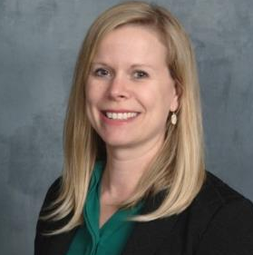
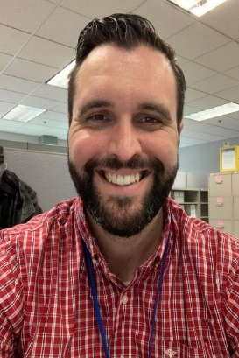
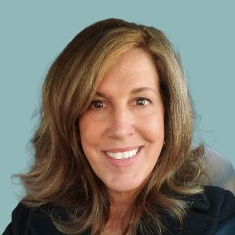
Your Dedicated Partnership Team
Kelly Fehring, FLMI, ACS, CLU
Member Relations Director
kfehring@limra.com
(513) 384-8061
Mike Rand
Member Solutions Director
mrand@limra.com
(860) 285-7871
Barb Kimball
Member Solutions Director
bkimball@limra.com
(860) 214-3350
Notes:
Deeper dive opportunity: average goals, compensation insights, delegation of activity. Advisor perspective….what are they selling and why not more.

Slide 12
Questions?
Questions?

