Slide 1
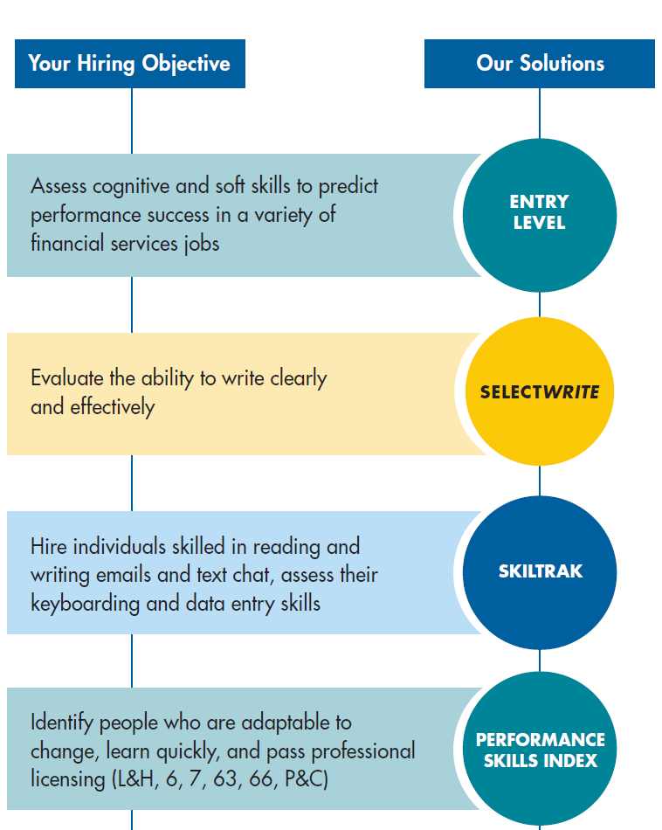
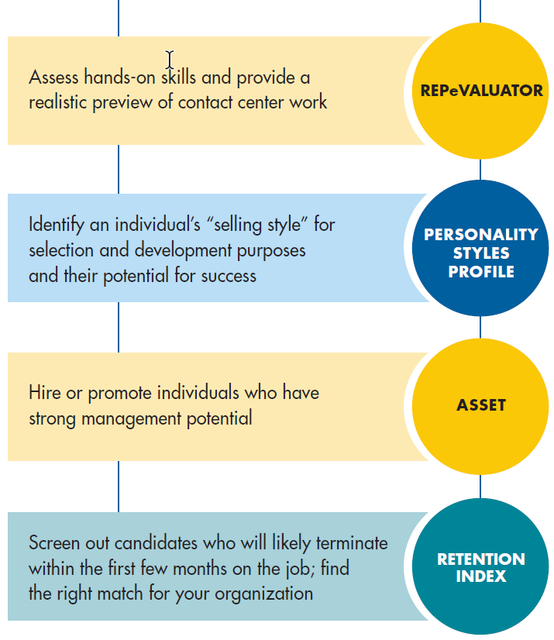
Achieve Your Employee Recruiting and Selection Goals
Wide Range of Positions

