Slide 1
Talent Solutions Assessing Key Competencies to Hire Top Talent

Slide 2
Agenda
LIMRA & LOMA Overview
Performance Skills Index with Learning Styles Overview
Implementation
Next Steps
Q&A
Notes:
Good afternoon!
Happy to be here with all of you. I’m Angelina Weeks, Member Solutions Director with LIMRA.
Over the next 45 minutes we will be sharing several key pieces with you and I’m just going to take a moment to walk through our agenda for this afternoon. To start we’ll introduce you to our organization and a few of our many talented team members.
The majority of our time will be spent providing a thorough overview of our assessment – PSI with Learning Styles including implementation and next steps. And in the last 10 minutes or so we will open it up for questions.

Slide 3
About Us
Largest trade association in the world serving financial services
LIMRA
LOMA
Premier financial services industry research organization
Flagship for industry professional development
Serving members for over 100 years.
Over 700 member companies in 66 countries.
Life Insurance
Annuity
Workplace Benefits
International
Notes:
We are the largest trade association in the world serving financial services. LIMRA grounded in being known as a premier financial services industry research organization and LOMA our flagship for industry professional development.
Serving members for over 100 years and with over 700 member companies in 66 countries.

Slide 4
Diverse and Robust Membership
Notes:
This is just a small piece of our footprint. We proudly partner with an incredibly large and diverse audience of members including Morgan Stanley.

Slide 5
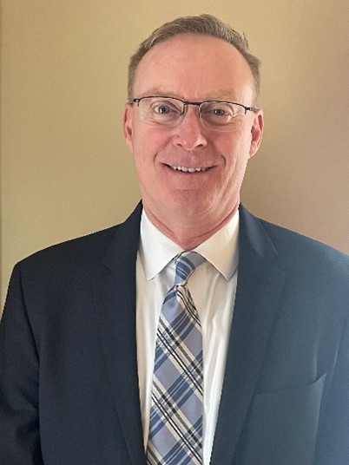
Our Experience & Our Team
Chris Callahan, CRPC, CRPS
Member Relations Director
As a 34-year financial services veteran I have spent the majority of my career in the annuity, retirement and insurance space.
Most of my industry experience comes from being in the field as a wholesaler and retirement specialist.
I have worked with sales, marketing and product development leadership at insurance companies and financial institutions to create awareness of the importance of retirement planning and asset protection.
Angelina Weeks, CLF
Member Solutions Director, Talent Solutions
I joined LIMRA in June 2023, bringing 18 years’ experience in the field holding a variety of leadership roles within our industry charged with growth initiatives for agency and advisor development, focused on recruiting, retention, coaching, sales training, KPI management, vertical and horizontal growth oversight, internship and future leaders’ development.
Kathy Reid, MS, LLIF
Vice President, Client Success
I lead a team of professional assessment and development experts who deliver global solutions to help our members recruit, select, assess and onboard new talent. I joined LIMRA and LOMA 35 years ago prior to having experience in a field role focused on recruiting and sales. I enjoy working with our members to evaluate their selection processes for effectiveness and help them develop their skills around recruiting and assessing top talent for their organizations.
Ina Allison, Ph.D.
Director of Assessment Research
I hold a Ph.D. in Industrial Organizational psychology. I am responsible for ensuring our solutions are effective and adhere to the industry’s highest assessment development standards. In my 31 years with LIMRA and LOMA, I have researched, designed, and validated many of our existing assessments and worked with numerous companies within the financial services industry on issues related to recruiting, selection, and performance development.
Emily Spicer
Product Manager, Talent Solutions
I have a Master’s Degree in Industrial and Organizational Psychology and have been with LOMA for 24 years. My expertise lies in developing and managing employment assessments to support effective talent acquisition and development strategies.
Notes:
Our staff has over 50 years of combined assessment experience
(including an Industrial Psychologist on staff) and over 40 years of providing assessment tools.
Serving members in all facets of insurance: Life, Health, P&C, as well as Financial Services companies.
Joining me today from LIMRA and LOMA are Kathy Reid, Ina Allison and Emily Spicer – they are each subject matter experts in their own rights and will be part of the conversation today.
My partner Chris Callahan, MRD was disappointed he could not make it today but he was traveling to visit another of our members.

Slide 6
What Makes Us Unique
We understand the hiring and onboarding challenges unique to our industry and draw on historically broad and deep data sources in support of our assessments.
Anchored in Research
By the Industry, for the Industry
Continuously Measured and Validated
53 Million Candidates Evaluated
Notes:
While there are many options you have to consider when incorporating a hiring assessment what makes us unique is that ours are specifically designed for the financial services industry and draw on historically broad and deep data sources to support our assessments.
With 53 million candidates evaluated we’ve been able to continuously measure and validate our assessments.

Slide 7
The Results
50% increase in the pass rates for the FINRA SIE exam
Bottom line benefit of more than $1 million savings due to reduced expenses from fewer mistakes in processing claims and improved workflow management
Drop of 40% in customer complaints
Notes:
Acquiring the right talent is the most important key to growth. Hiring was – and still is – the most important thing we do. The cost to onboard a home office employees can range from $25-$60K depending on the role. If you are not selective, that money is no longer an investment.
What you see are the results from using our assessments to help reduce the risk of turnover rates as well as the loss of revenue.
Read stats on page

Slide 8
Performance Skills Index with Learning Styles
Candidates
Extremely predictive
Identifies those who will likely pass exams on the first attempt
Identifies those who need extra help preparing for exams
Validity
In accordance with Uniform Guidelines on Employee Selection Procedures (1978)
Validated for insurance and wealth management advisors & representatives, and contact center representatives
Details
Cognitive: verbal knowledge and logic, reading & math
45 questions/45 minutes
Learning Styles: 31 behavioral statements and insights to support training
Interview questions: guide for follow up conversations
Notes:
Performance Skills Index (PSI) with Learning Styles – An assessment to help companies identify strong candidates who are likely to pass their licensing exams.
• Predict the likelihood of passing licensing exams on the first try.
• Screen out candidates who are unlikely to succeed with the exams.
• Identify candidates who will need extra help preparing for them.
The validity for Performance Skills Index conforms to the reporting guidelines specified for criterion-related validity studies in the Uniform Guidelines on Employee Selection Procedures (1978).
U.S. and Canadian companies with service and sales offices that primarily serve the financial services industry participated in this study.
Financial services representatives are often required to have professional licenses. LIMRA has conducted task and attribute-oriented job analyses of these positions (LIMRA Inc., 1984, Crosby, 1988, McManus, 1995). We also gathered information on these jobs available through the Occupational Information Network or O*NET (2010).
Multiple Choice assessment that measures verbal knowledge and logic, reading, and math. There are 45 questions and candidates are given 45 minutes to complete the assessment.
The PSI assessment has an additional section that can be included that identifies a candidate’s primary learning style, which will help companies effectively train their new hires or interns. This portion is not timed and takes approximately 10 minutes to complete.
Learning Styles – identify a person’s way of thinking, reflecting and learning.

Slide 9
Performance Skills Index with Learning Styles
.
Life & Health
Property & Casualty
SIE Exam
Series 7
Series 63
Series 6*
Series 66*
*In process of updating validation study for Series 6 and 66
Notes:
The Performance Skills Index predicts candidates’ ability to pass life and health insurance, property/casualty insurance, and FINRA licensing exams. It also assesses an individual’s capacity to learn and remember new information. PSI scores are predictive of performance in contact centers. Generally speaking, people who have higher learning ability will perform better on the job.
The PSI assessment has an additional section that can be included that identifies a candidate’s primary learning style, which will help companies effectively train their new hires or interns. This portion is not timed and takes approximately 10 minutes to complete.
Assessment determines one’s ability to pass a licensure exam on the first try.
Evaluates candidate’s cognitive skills in math and verbal reasoning.
Provides additional insight to the preferred learning style.

Slide 10
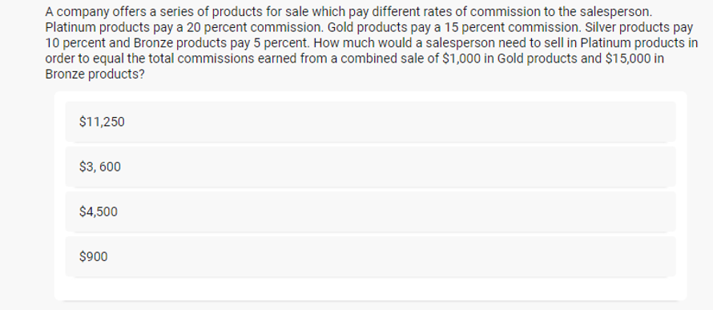
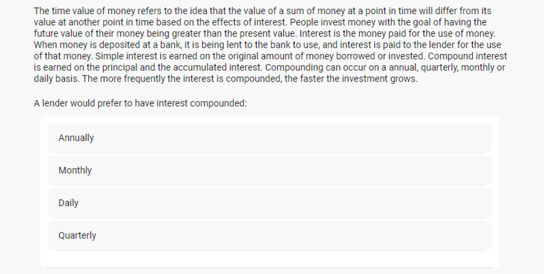
Performance Skills Index with Learning Styles
Notes:
These are a two samples of math and verbal questions a candidate will be asked on the assessment.

Slide 11
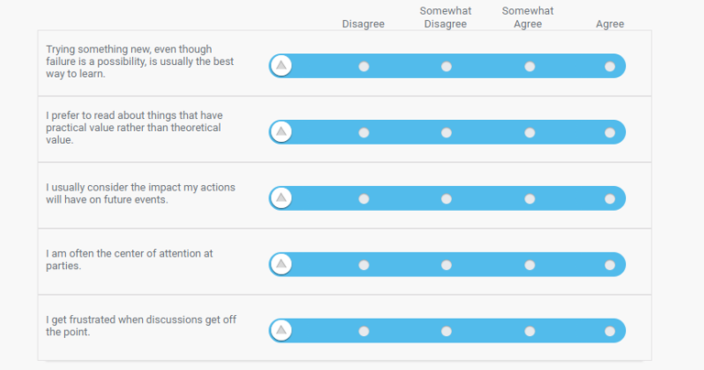
Performance Skills Index with Learning Styles
Notes:
Next here is a sample from the learning styles section of the assessment.

Slide 12
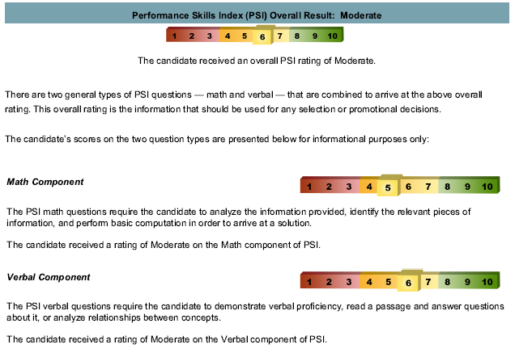
Performance Skills Index with Learning Styles
Notes:
This first portion of the PSI report shows the candidate’s overall score and indicates if the score is in the high, moderate, or low range. The overall rating is what should be used for selection and promotional decisions. The report also shows how the candidate performed on the math and verbal components of the test.

Slide 13
Performance Skills Index with Learning Styles
Notes:
The next section of the report shows a breakdown of the likely outcome for scoring across the different licensing exams.
Depending on the licensing tests your companies uses, the report will show the candidates’ probability of passing the exams on the first attempt. The expected exam performance can help you identify candidates who will need extra help preparing for them and screen out or redirect candidates who are not likely to score well on the exams.

Slide 14
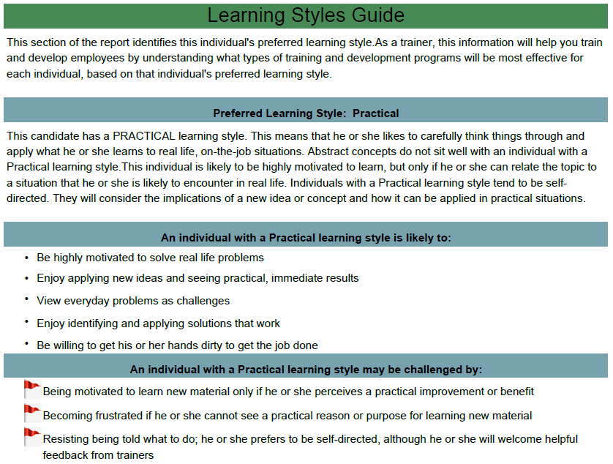
Performance Skills Index with Learning Styles
Active
Prefer to learn by doing
Practical
Prefer to apply learning to practical, everyday outcomes
Theoretical
Prefer to take a methodical, logical approach to learning
Notes:
The Learning Styles section includes information about the candidate’s preferred learning style. A learning style is a way of thinking, reflecting, and learning. This information can help train and develop employees by identifying preferences for learning and areas of challenges for candidates with those learning styles.

Slide 15
Interview Questions
Notes:
Additionally, interview questions are provided based on areas of concern for those with their particular learning style so those areas can be further explored.
This is the report that they receive.

Slide 16
Notes:
I know there is a lot of detail on this slide and you will all receive a digital copy.
Essentially, this is what we do with our PSI Users at no cost for our members. We work with you so that you know the impact PSI can have. A tangible piece that you can use internally so you can speak to and show the value.
Case Study Findings:
A member company supplied LIMRA and LOMA with the licensing results and those were matched with 240 candidates.
The analysis showed that the candidates that scored the highest on PSI were:
Twice as likely to pass SIE on the first attempt
Three times more likely to pass the Series 7 on the first attempt
24% more likely to pass the Series 63 and 66 than those that scored in the moderate range.
These findings provided by a member for their own internal validation.
Similarly E-Trade used our PSI assessment for 10 years and we do have the data and findings from that time.
Curious if anyone here is from E-Trade and may recall?

Slide 17
Implementation
Step 1: Work with an Onboarding Specialist for set-up options*
Step 2: Train administrators (virtually)
Step 3: Data analysis & validation (after 100 tests and exams matched cases)
Step 4: Quarterly calls for continuous alignment
*ATS Integration
Notes:
Your dedicated Onboarding Specialist will work with your company to set up the testing platform to best work with your needs.
Example of set up options:
location structure
retest policy
customize welcome screen and candidate emails
billing information
ATS Integration?
Identify Administrators
Training virtually – only takes 30 minutes
Specific data analysis for Morgan Stanley once you reach 100 tests and 100 exams scores
Quarterly calls – we want to be sure we continue to understand your business practices and make sure the test are in alignment with your initiatives and goals.
While I won’t go through all the set-up options, I do want to point out one important one -- with most of our larger clients, we do an ATS integration which can help save time from an administration and reporting standpoint. We integrate with most all of the common ATS providers (such as WordDay, Taleo, Kenexa).

Slide 18
Next Steps
Demo PSI with Learning Styles assessment
Confirm roll out date
7-10 business days to complete set up
Onboard and train administrators
Notes:
If you walk away with one thing today, I’d highlight the significant positive impact the PSI with Learning Styles has on your overall onboarding and retention. Sourcing and hiring candidates is not an easy lift and with the right tools it can help bridge the gap on challenges you might face in that process, reduce turnover rates as well as the revenue used to invest in hiring, onboarding and training candidates to effectively prepare them for their role.

Slide 19
Questions & Your Key Contacts
Chris Callahan, CRPC, CRPS
Member Relations Director
Phone: 908.873.8818
Email: ccallahan@limra.com
Angelina Weeks, CLF
Member Solutions Director, Talent Solutions
Phone: 860-285-7793
Email: aweeks@limra.com
Notes:
Chris Callahan and I support all of our member companies in the Northeast and we’re happy to connect for any follow up that may be needed after today’s meeting. I know I’ve covered a lot of information and at this time, I’d like to open it up for questions.

