Slide 1

Notes:
I’d like to welcome you to the Trustworthy Selling Preview Day session. We’re excited that you and your organization will be taking part in an overview of this ground breaking sales effectiveness program. We’ve found this is the best way to experience the Trustworthy Selling curriculum.
Over the course of our time together we will:
Review the latest LIMRA research that impacts productivity
Share productivity results and why this program is exploding throughout the industry
Provide highlights of each of the three editions in a module-by-module review

Slide 2

Lost Art of Selling
Notes:
The first reason we developed TS was to recapture the lost art of selling
In the work we do with our client companies, we heard repeatedly about the need to grow productivity. Managers often lamented “these young people don’t know how to connect with people face to face”, they need to learn how we learned to sell in the business.
Well if you think about it, since the late 90’s, the industry and its training had shifted to a heavy focus product, technology systems and regulatory issues. Somewhere in the mix we lost our focus on the art of selling…..
Now flash forward ten years to today. Technology has brought with it many advantages but the latest recruits, raised as digital natives, have even more gaps in terms of soft skills than their predecessors do.
Technology has had an impact on our prospects and clients too. It has brought forth the emergence of the empowered, tech-enabled consumer. This requires us to put the client center in everything we do, in order to fulfill on their expectations for buying and servicing experiences. Reps need more art now than ever!

Slide 3

Trust is the “Attribute Under Siege”
Has become significantly more difficult to trust advisors now, versus five years ago
50%
24%
11%
85%
Has become significantly more difficult to build trust with client now, versus five years ago
26%
50%
14%
5%
59%
Sources : MDRT Generational Survey; MDRT PREP Survey
Notes:
Another reason we built TS is the low confidence and low trust among consumers. This was the case when we built the program and the trust issue has, if anything, only gotten worse since then.
The MDRT asked consumers across all generations if it has become more difficult to trust advisors today vs. 5 years ago. 85% of consumers say YES. But when the same question was posed to advisors only 59 percent believed that to be the case —
So there’s this blind spot for our advisors not really realizing just how hard it is to win the trust of today’s consumer. Or how significant the trust crisis is to every interaction and every step in the sales process.

Slide 4
Strong Demand in the Market
48 million
U.S. households believe
they need more life insurance
29 million
State they are “likely to
buy in the next 12 months”
Only 12%
Of U.S. households buy
life insurance each year
35 Million Households Have No Life Insurance At All!
Source: LIMRA Household Trends in U.S. Life Insurance Ownership
Notes:
The third reason we created TS is that there is strong demand for what we do in the market place.
For instance if we look at the life insurance need in the US, It’s a very visible need. When surveyed:
58 million HH “say’ they need more life insurance,
35 million report having no life insurance at all
29 million state they intend to buy this year
BUT in any one year only 12% act on that intention to buy – because inertia and procrastination sets in
This same scenario plays out all over the world and not just with life insurance. Which is why you’ll find market research and related language and techniques woven throughout the entire program.
Trustworthy was built on the premise that if we stopped focusing on selling our products and started focusing on motivating today’s consumer to act on their intention to buy – we’d sell more product!
So the question becomes: what's creating this inertia and procrastination?

Slide 5
Consumers are Afraid and Confused
43%
of households report being afraid of making a mistake in their financial decision making
5 out of 7
consumers report being more confused after they met with an advisor than before
Notes:
There’s a number of reasons for this inertia and procrastination among today’s consumer that we address in the program. However, there are two primary reasons we’ll share today – Fear and Confusion
43% of households report being afraid of making a mistake in their financial decision making.
And this one is really sad - 71% of consumers report being more confused after they met with an advisor than before!

Slide 6

Reduce Tension & Anxiety
63% felt tense or anxious
87% - advisor reduced tension/anxiety
Notes:
So why people don’t buy even though they know they should and say they are going to, is largely because they feel anxious with the whole process and with US.
BUT - those who do buy, say the advisor played an active role in reducing that tension and paved the way for better decision making by the client…
So what in particular did they do?

Slide 7

Advisor Behaviors Associated with Purchase
94%
gave me complete attention
91%
was very knowledgeable
90%
listened without interrupting
84%
had my best interests in mind
89%
built rapport
81%
spent time determining my specific needs
Notes:
Read slide
In the end when the advisor displayed these behaviors in the initial meeting they were perceived more often as “someone I could trust” by prospects.
All are behaviors we felt strongly we could have an impact on. And ten years on, our convictions were right.

Slide 8
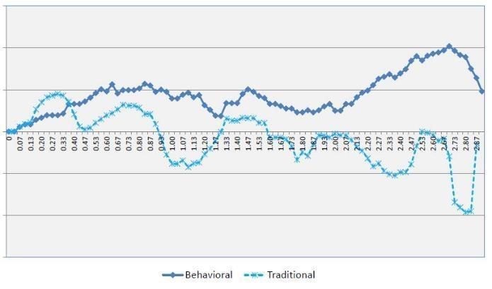
Behavioral Economics Moves People
29% higher
likelihood to buy
+1
0
-1
Notes:
Now let’s look at the final reason we built TS – the learnings we have from Behavioral Economics.
Behavioral economics has been around since the late 1970’s but had never been studied specifically in the financial services industry.
LIMRA conducted research using the principles of BE and specifically looked at how to present products and advice to potential buyers of insurance and retirement plans.
The study uncovered seven techniques that if incorporated into a sales presentation, greatly influence the prospects’ willingness to buy. Using a continuous clicker methodology, it compared sales presentations both with and without these techniques to see if they improved the likelihood of buying. (The light blue line is the traditional sales track, dark blue the BE sales track.)
The result? Consumers reported that they were 29 percent more likely to buy from a professional who incorporated behavioral economics techniques into the sales presentation than from a professional who simply focused on facts and information.
The key finding here is - what you say and how you say it in the sales process makes a big difference in one’s likelihood to buy.
Thus the premise for the course – stop selling product/start motivating consumers to do what they know they need to do – which means engaging them emotionally in the process.

Slide 9
The Program
Between two mighty, enduring and ever changing oaks grew a doorway to a new world.
Notes:
With that context, let’s look at the actual program.
Trustworthy Selling 2.0 is so much more than a sales effectiveness program. It is a dynamic, evolving, immersive experience designed for the modern learner that bridges the gap between needed foundation, retention and the human connection. Let’s take a look.

Slide 10


Built By the Industry For the Industry
Field-Tested
Language & Techniques
“The Art”
Research
“The Science”
Notes:
LIMRA and the Hoopis Performance Network collaborated to create this program specifically for the financial services space.
It’s a first of its kind –a research organization partnering with a proven field practitioner to combine The Art and Science to increase productivity and retention. The Science is the LIMRA research and The Art is HPN”s field-tested language and techniques of top producers.
It’s been a courageous partnership founded on making a difference and changing an industry that’s been searching for an answer to growing productivity and retention.
It teaches us to sell by listening, to advocate rather than pressure, to collaborate and foster for the long term. It gives us the tools to grow from within and the confidence to build enduring relationships.
It is battle tested and built from the voices of the industry.

Slide 11

Trustworthy Selling Accolades
Over 30,000 graduates
2024 Top 25 Sales Training Companies – Selling Power
ROI Institute’s “Top 10 Case Studies of the Year”
Recognized by The American College as an elective towards the FSCP™ Designation

Slide 12
Productivity Impact - Over Three Dozen Companies
25+%
Premium
Policies
New clients
P&C productivity
Investment gross revenues
Production credits
Lives
Submitted
Placed
Weekly net issued
Conference credits
Retention
Increases on average across the board
Notes:
And now we are witness to double digit lift in every metric our client companies ask us to measure
These are the numbers you see in our marketing and they most often represent pre/post data at 3 months from users of the program.
However, we have tracked year over year results from a company’s entire annual recruiting class.

Slide 13
Capstone & Action Planning
Seller Psychology
Business Development Strategies
Engagement Strategies
Collaborative Discovery
Gaining Commitment
Deepening the Client Relationship
Trustworthy Selling Approach
Understanding Today’s Consumer
Understanding and Adapting Your Selling Style
Personality Styles Profile
Sales Booster
Notes:
Combining proven language with leading research, dynamic tools and new technology, Trustworthy Selling partners with you to build a more powerful, loyal, and productive distribution.
This is the curriculum visually laid out as the “House of Learning” or “House of Sales” as it’s sometimes referred to. At a high level, there are 10 modules and about 4 full days of content (typically delivered over the course of several weeks or months).
At the foundation – There are two Industry validated assessments packaged and delivered as pre-work to the program, allowing participants to individualize the learning experience and grow from who they are.
First floor - The first three learning modules set the stage for the entire curriculum, enabling participants
to understand the mindset of today’s consumers and how their own selling style impacts the sales process. This content creates what we refer to as the “psychological readiness” to learn new knowledge and skills.
Second floor - The next five modules are the tactical elements of the Trustworthy Selling approach – these demonstrate — and help participants master — the language, skills and strategies that resonate with today’s consumers.
Third floor and roof - The final two modules are designed to motivate participants to apply what they’ve learned and maintain peak performance when executing the seven disciplines of trustworthy sales professionals. They will participate in a master case study as part of the CAPSTONE for this program and be asked to demonstrate the language and skills they learned in Trustworthy Selling.

Slide 14
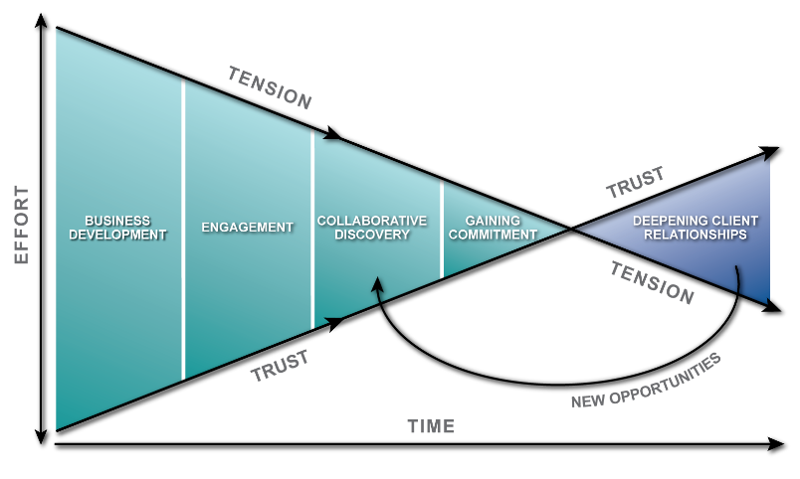
The Trustworthy Selling Model
Notes:
This is the Trustworthy Selling Model and philosophy – it’s designed to be a reminder that relationship tension is high at the beginning of the sales process and the advisor’s role is to incrementally reduce tension at each step in the process while continuing to build trust in each phase.
Also, the most amount of effort is typically on the front end of the sales process. If you’re applying the TS skills and techniques, each step in the sales process should become easier. By the time you get to the “close” or Gaining Commitment, it should just feel like the next, natural step in the process. The prospect shouldn’t feel like they’re being closed at all. The point at where tension and trust meet is where someone becomes a client.
Most important to point out with the Model is that TS is not a sales process. Most companies already have a sales process. TS is a sales effectiveness program that works in conjunction with your company’s existing sales process.

Slide 15




Editions of the Program
Full Program (10 modules of content)
Full Program
Multiline Edition
Modularized
Program
SkillSet powered by TS
(Bus Dev & Coll Disc)
New to the Business
Quick Start
Experienced
Professional
Notes:
Trustworthy is expanding. We are creating new iterations of the program in order to accommodate our member company’s development needs.
For a LI and RM advisor development opportunity we offer our full program (10 modules of content) in a Quick Start edition for those brand new agents to get them launched quickly into the business, and a Professional edition for those FPs that have been in the business for 6 or more months.
And, for the Multiline agent the Quick Start and Professional editions are also available.
In 2022 we brought the Modularized content design to the market. We have this content available in a Quick Start Edition and a Professional Edition. Providing our client companies with the ability to pick and choose the modules right for them.
And, in 2023, we created the SkillSet version of the program. Again available in the Quick Start and Professional editions. SkillSet is designed for sales professionals at any stage in their career and have a good understanding of a company’s sales process, products, and have a client base to work with. These individuals are looking for ways to:
Sharpen their skills to drive higher productivity.
Grow their business by accelerating the process from business development to sale.

Slide 16
Full Program Components
Comprehensive learning system comprised of 24 hours of training content
10 Instructor-Led Modules covering array of content:
Strategic insights from consumer research
Tactical application of insights to grow sales
Psychological awareness of self and others
2 Industry-validated assessments
Personality Styles Profile
Sales Booster
Supplemental Resources
Infographics
eLearning Knowledge Reviews
Resources for Results that provide step-by-step processes, sample language and tools
Coaching Tools and Resources

Slide 17
Modularized Program Components
Our Modularized Trustworthy Selling content focuses on the tactical training modules from the Trustworthy Selling House of Sales that deliver the sales skill elements which support your sales professional’s development opportunities to take their business to the next level.
Pick and choose the modules right for your organization:
        Understanding Today’s Consumer
        Understanding & Adapting Your Selling Style
        Business Development Strategies
        Engagement Strategies
        Collaborative Discovery
        Gaining Commitment
        Deepening the Client Relationship
        Seller Psychology
Supplemental Resources
Infographics
eLearning Knowledge Reviews
Resources for Results that provide step-by-step processes, sample language and tools
Coaching Tools and Resources

Slide 18
SkillSet powered by TS Program Components
SkillSet is a 1-day program (6 total hours of delivered content) that can be delivered in a live classroom setting or virtually.
SkillSet offers a pre-learning opportunity which introduces the learner to Trustworthy Selling and our Trustworthy Selling model.
SkillSet focuses on the core sales effectiveness skills of
Business Development Strategies
Collaborative Discovery
with the goal of helping sales professionals get in front of the right potential clients, build trust quickly, and identify the needs and desires of the potential client through the art of questioning so they can make proper recommendations.
SkillSet is easy to implement, easy to execute!

Slide 19
Turnkey Learning System
Notes:
We recognize that today’s changing dynamics demand more dynamic solutions - challenging to build, and even more challenging to evolve in-step with your market and consumers. Organizations no longer need to build their own because we’ve listened, we’ve learned, and we’ve built the program that answer their needs.
Let’s take a deeper look at the components of the program

Slide 20
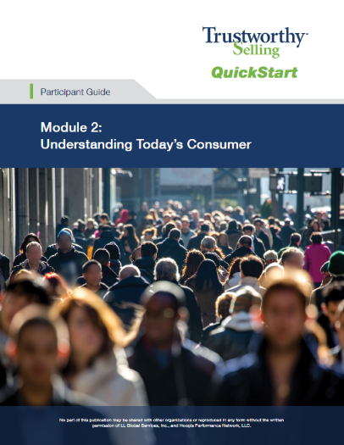
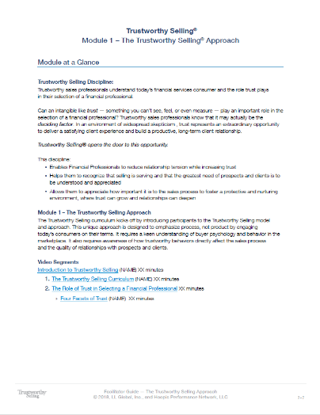
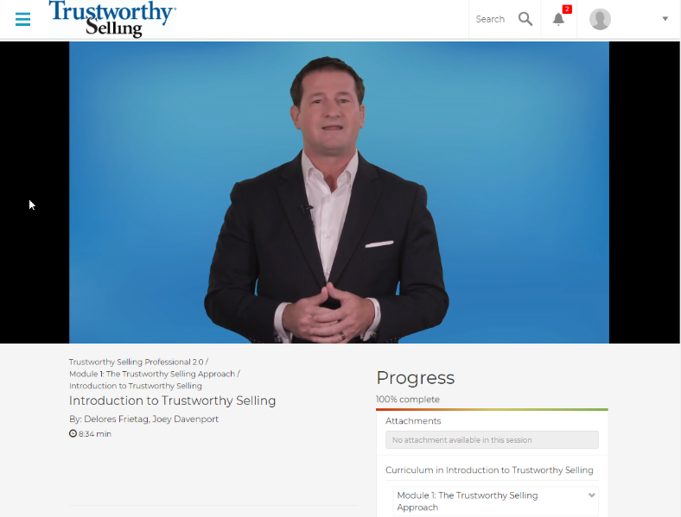
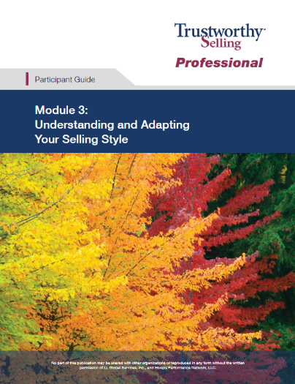
turnkey
Notes:
Trustworthy Selling was built as a totally immersive, comprehensive learning system that packages together everything you need to deliver a first class and effective training program. There is no content to tailor, or modify, it’s a turnkey system.
Fully scripted facilitator guides tell you exactly how to tee up content, debrief content, lead group discussions and run adult learning activities.
The subject matter expertise in the program is delivered via online video. So facilitators don’t have to become subject matter experts which removes a tremendous amount of heavy lifting off their shoulders. This also creates consistency in the message being delivered in the core content as well as scalability as it pertains to implementing company-wide.

Slide 21

Learning Path
Discussion Starter
Context Video
Application Videos
Debrief Discussion
Activity/Exercise
Debrief of Activity
Recommended Actions
Supporting Resources
Notes:
The TS learning design is adaptive and forward thinking, catalyzing change. Every module contains multiple adult learning components to drive variety, engagement and a thorough learning experience for the modern learner.
Every module contains multiple segments.
Every segment contains a debrief discussion and one or more adult learning activities to practice and reinforce skills
In general, the learning path for each of the segments follow a variation of the path you see on the screen here.
Each module contains value added content such as infographics, language frameworks and eLearnings to help drive home concepts and skills
The entire package is designed to support you and your facilitators in delivering professional sales training in your organization.

Slide 22
TS 2.0 Video Library
Context video – animated
Application videos – live actor/SME
Language demonstration videos – live actor
WHY?
WHAT?
HOW?
Notes:
The TS 2.0 video library is made up of three different kinds of video:
Context videos – provides the reason for behavior change, incorporates research and statistics to magnify the issue, animated so we can keep fresh with new insights – “the why behind the what”
Application videos- provide the skill demonstrations, techniques and best practices related to the context video. In other words, given the what we know about xyz (context video), here’s what you should do about it…(application video)
Language demonstration videos – show the language and techniques in action

Slide 23

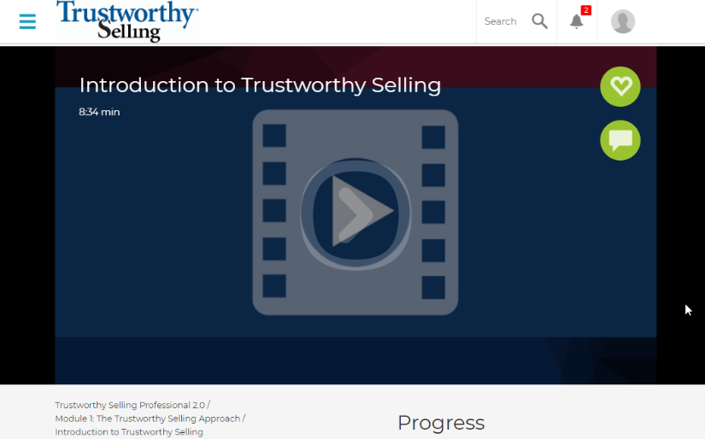
online
Notes:
The website is the central hub for the Trustworthy Selling program. Here we house all the student, facilitator and coach resources for the program. The content is organized by module and segment and can be assigned by facilitators and/or coaches.
The online platform is designed with mobile responsive design – so the content is accessible anywhere/anyhow for the participant to view on their smart device while in the field for just in time refreshers.

Slide 24

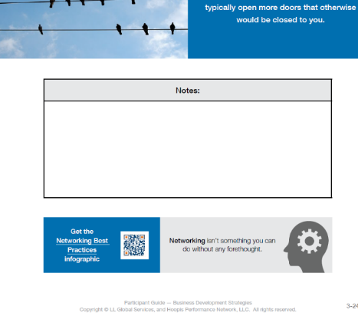


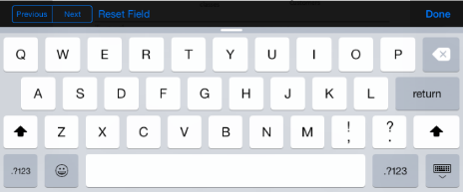
digital
  Contemporary Approach
  Links to Supporting Materials on Website
  Easy Field Distribution
Notes:
The participant guides are “full digital”, capitalizing on the opportunities digital guides afford us. Participant Guides are fully interactive with hyperlinks and QR Codes to videos, infographics, resources for results, external resources, and language demonstration videos. They are graphically rich and engaging.
The benefits of going digital:
For participants – always have access to content/notes and can direct link to relevant content on the program website
For companies – reduces hassles of shipping and printing binders and provides a contemporary learning approach for their participants

Slide 25
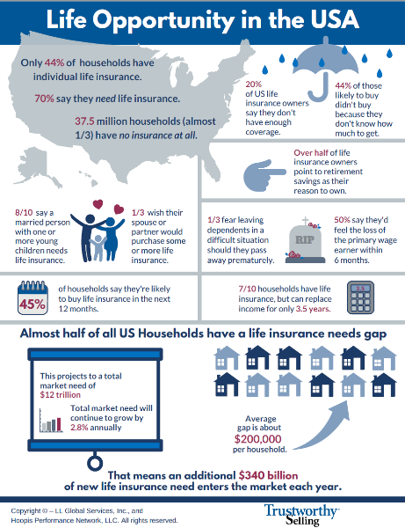
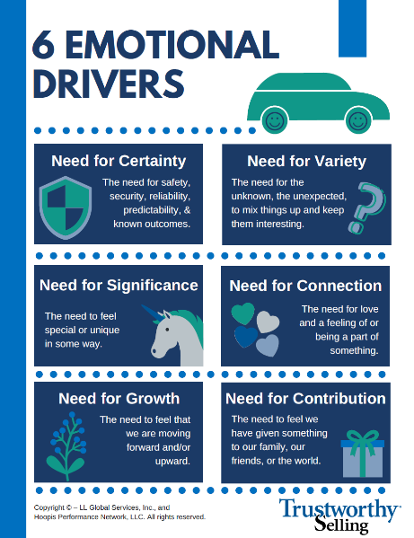
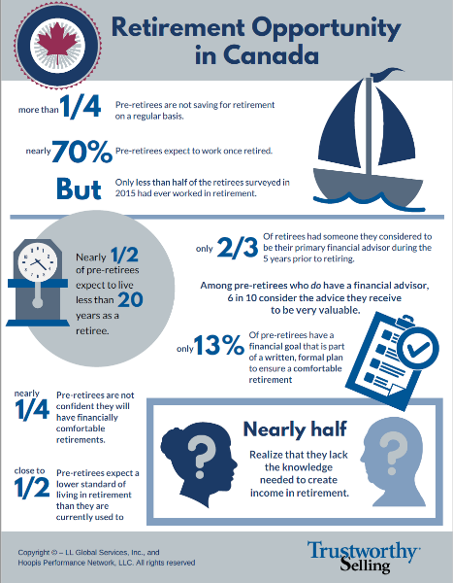
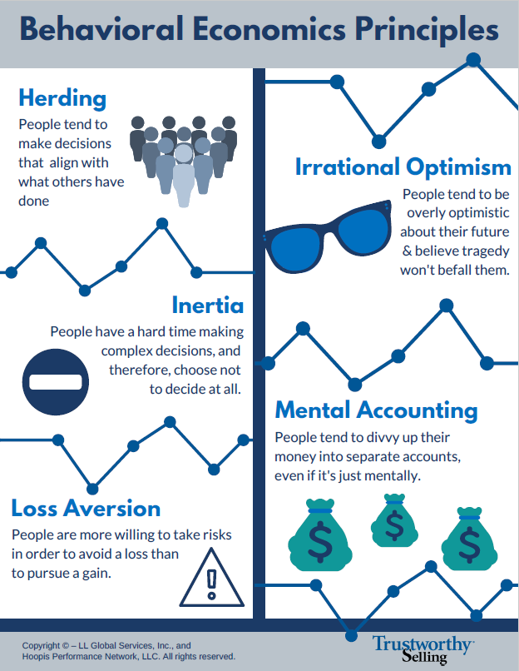
insight-rich
Key Concepts
Research Nuggets
Notes:
About 50 infographics support the TS program. Participants have links to these helpful infographics throughout their Participant Guides via hyperlinks or QR Codes. The participant can use these to reference following the program to recall key concepts.
There are two types of infographics:
Infographics that provide a snapshot of the research nuggets and put them in an actionable format that can be used as language with prospects.
And infographics that support the key concepts from the program pertaining to skills and techniques.

Slide 26
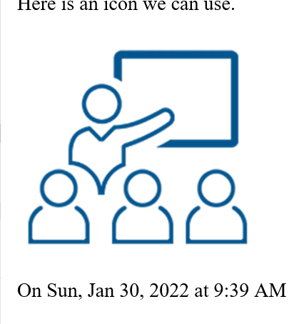
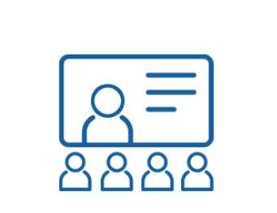

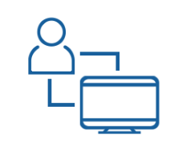
Live Classroom
Virtual Classroom
Self Study
Blended Learning
Notes:
Our materials are designed for Instructor lead delivery – either live in a classroom setting or in the virtual classroom; and we offer some modules in a self-study format to help break up your inperson delivery sessions. So, you can basically have it your way (Blended Learning)… delivering the foundational modules in a self-study format, delivering the tactical modules in the live classroom, delivering Seller Psychology in the virtual classroom and then bring everyone back to together for Capstone in the live classroom.
Trustworthy Selling is highly structured and highly flexible to accommodate any delivery model. The LIMRA/HPN team is in a unique position when it compared to other training organizations. We understand you, understand the industry, and know the product inside and out. We know what success looks like across many different organizations and channels. As such, we can consult with you to develop the most suitable delivery model for your unique needs, whether that be through the standard delivery model or something tech-enabled using our team of skilled facilitators.
The standard delivery model is designed for traditional, instructor-led classroom delivery, using certified company facilitators. The subject matter expertise is provided through streaming video, enabling consistency and standardization of training. A key role for the facilitator is to bridge the agency’s culture with the Trustworthy Selling concepts. Facilitator certification is conducted through virtual delivery, so extensive time is not taken out of the field.

Slide 27
facilitators
STEP 3
Prep for Live Virtual Demo
STEP 4
Live Virtual Demo
STEP 5
Prep for Program Delivery
STEP 1
Prep for Facilitator Certification
STEP 2
4 Self-Paced eLearning Modules
Live Demo
2 Hour Virtual Class
Introduce yourself
Introduce program
Facilitate a segment
On-boarding and Certification
Notes:
We’ve certified over 750 facilitators and the feedback we receive on the certification process is very positive.
Because the subject matter expertise is delivered via video, the facilitators do not have to become subject matter experts.
The process is made up of a blended learning curriculum that begins with self-study interactive eLearning modules and is anchored by a 2hr virtual demo presentation. Typically, facilitators are up and running in about 60 days.
This makes the certification process efficient and streamlined. So there’s no need to travel somewhere and spend 3-4 days getting certified (which is typical for most programs of this caliber).

Slide 28
coaches
STEP 2
2 Self-Paced eLearning Modules
STEP 3
Attend Trustworthy as a Participant
STEP 4
Conduct Coaching Sessions
STEP 1
Complete Program
Pre-Work
On-boarding and Certification
Notes:
We’ve certified over 750 facilitators and the feedback we receive on the certification process is very positive.
Because the subject matter expertise is delivered via video, the facilitators do not have to become subject matter experts.
The process is made up of a blended learning curriculum that begins with self-study interactive eLearning modules and is anchored by a 2hr virtual demo presentation. Typically, facilitators are up and running in about 60 days.
This makes the certification process efficient and streamlined. So there’s no need to travel somewhere and spend 3-4 days getting certified (which is typical for most programs of this caliber).

Slide 29
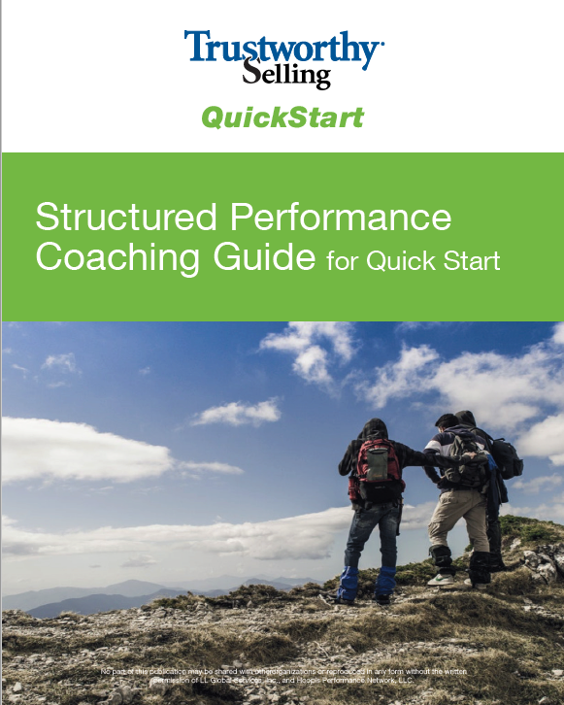
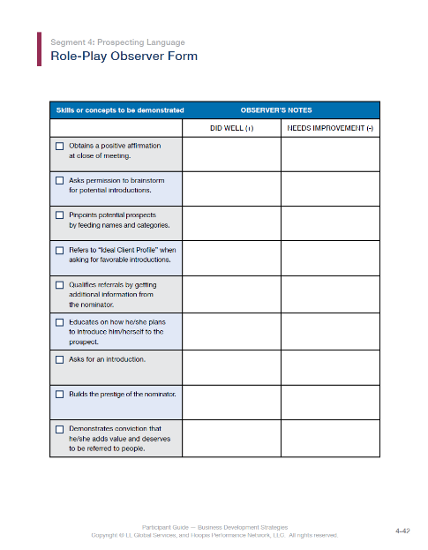
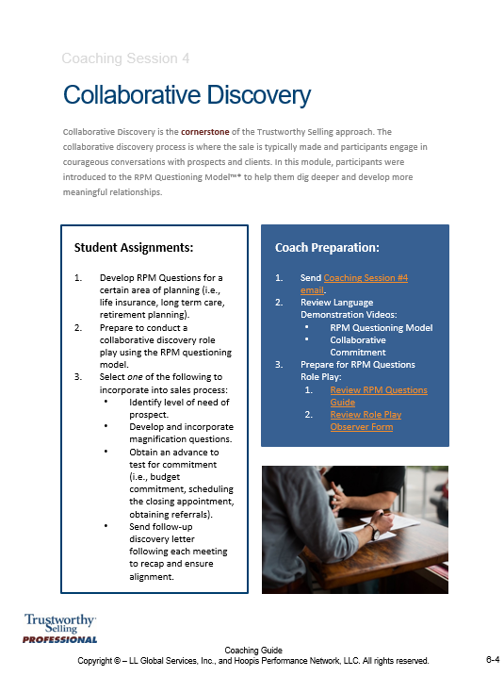
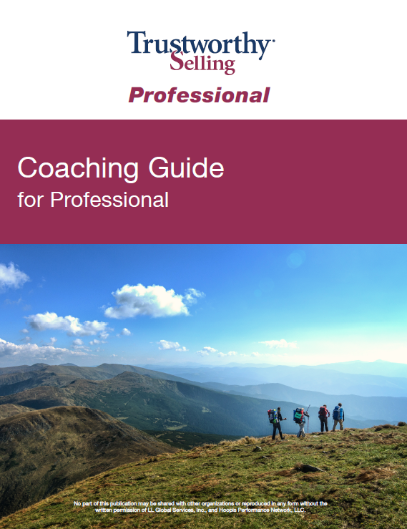
Coaching Guides
Notes:
Coaching is a critical component, so we package coaching guides fully aligned with content and certify coaches with our Coach the Coach eLearning program (coaches must also complete the program in its entirety one-time).
Participants, coaches and facilitators receive coaching materials, so that this critical accountability component stays in focus throughout the curriculum.
In addition, coaches can assign content prior to coaching sessions from the program website.
There are five core one-on-one coaching sessions built into the program, but additional resources for group coaching and 30, 60, and 90 day follow-up are included as well.
Our analysis shows markedly higher results in companies that support a high coaching environment

Slide 30
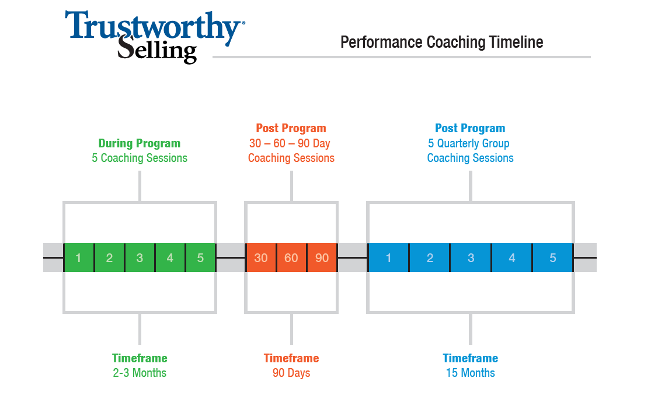

Slide 31
What happens when you add coaching?
Trustworthy Selling QuickStart with Coaching
 | Survival | Policies | Annualized Premium | Investment FYGR | First-Year Commissions
HI Coaching vs LO Coaching | 57% | 33% | 38% | 46% | 48%
Notes:
Twice during the training program participants were asked to rate the coaching that they were receiving from their branch managers. Participants used a six-point scale ranging from strongly disagree (1) to strongly agree (6) to rate 13 aspects of coaching. Reps who reported receiving HI coaching (score GE 5) out-lasted and out-performed the reps who reported receiving LO coaching (average score LT 5).

Slide 32
Measuring Impact
Change is a continuous process. You cannot assess it with the static yardstick of a limited time frame. When a seed is sown into the ground, you cannot immediately see the plant. You have to be patient. With time, it grows into a large tree.
Notes:
Ten years ago, we imagined a program that would really make a difference in the industry and that would drive real sustainable growth for our companies.
We believed that the combination of art and science that you already heard about would be the equation for success. And today we know it is the equation for success.

Slide 33

Proven Impact on Productivity
in more than three dozen companies…
in every distribution channel…
(career, independent, hybrid)
In the US and Canada…
In life, multi-line, and investment space…
and across the seasons…
Notes:
Since 2011, we’ve measured the before and after impact of Trustworth Selling:
in more than three dozen companies,
in every distribution channel (career, independent, hybrid)
In the US and Canada,
In life, multi-line, and investment space
and across the seasons

Slide 34
Pick a Metric:
25+% lifts across the board
Premium
Policies
New clients
P&C productivity
Investment gross revenues
Production credits
Lives
Submitted
Placed
Weekly net issued
Conference credits
Retention
Notes:
And now we are witness to double digit lift in every metric our client companies ask us to measure
These are the numbers you see in our marketing and they most often represent pre/post data at 3 months from users of the program.
However, we have tracked year over year results from a company’s entire annual recruiting class.

Slide 35
Excellent Participant Value
rate
Trustworthy Selling
as a valuable use
of their time
93%
Notes:
Level 1 evaluation – Emotion - at conclusion of the program - commonly called “the smile sheet” This kind of evaluation measures how people liked the training on an emotional level and its value as an investment of time.
With an average length of service of 8.5 years for attendees who are very busy people, we are proud that 93% say it’s a valuable use of their time
This kind of evaluation answers the question: DO THEY LIKE IT?

Slide 36

Here’s What People Say…
“The whole process of Trustworthy Selling inspires me and increases my confidence before and during client/prospect meetings…”
“This program has re-energized me and helped me decide to stay in a business I love but was ready to leave.”
“This is one of the best and most applicable tools/programs that I have seen. Instead of saying ‘here’s a system you should buy’ it was, ‘here’s a wealth of information that will make your systems better.
“This is the only program I have experienced that puts all the critical information and knowledge you need to build a successful practice and become a top producer in one place… I highly recommend it.”
Notes:
Here are examples of some of the things they had to say in that level of evaluation (Read slide).
This answers - WHAT DID YOU LIKE BEST?

Slide 37

30 Day Behavioral Survey –
Participants reported changes in
36 out of 50 skills
Notes:
The next level of evaluation happens 30 days later. At this time we measure sustainable behavior change.
Of the 50 skills presented in TS, about 36 are actively in use by participants 30 days post program.
Actually all the skills are activated in varying degrees depending on your audience. In fact the top 5 skills cited are different by length of service which tells us there is something in it for everyone!
This answers for us: DO THEY USE IT?

Slide 38
ATD Case Study
Snapshot in one agency
31%
27%
18%
2%
3%
1%
Notes:
Our next level of evaluation, and perhaps the most important is what we call BIRT
This Business Impact Analysis began in 2012 with a case study
Pre-program productivity vs post program, same agency, attendees vs non attendees
These were the key metrics for that agency: Premium, Policy Count, and New Clients.
Today we have completed dozens of BIRT studies and track what ever measures are important to the company
This level of evaluation answers for us: DOES IT IMPACT PRODUCTIVITY?

Slide 39
TS Quick Start 12 Month Results
2017 recruiting class vs. 2018 recruiting class
82%
68%
71%
22%
Notes:
Another version of BIRT measuring participants going through the Quick Start Edition of the program which is designed to get new recruits off to a fast start.
These results represent productivity of an entire annual recruiting class (2015 vs. 2016 year over year productivity).
This is a hybrid company that sells 80% mutual funds and retirement products, 20% life insurance
Goal was to improve new advisor productivity and retention;
Outcome: they improved every metric including growth in investment gross revenue – which was not even expected!

Slide 40



Slide 41
Survival Trends Over Time

Slide 42
Policy Production Trends Over Time

Slide 43
Premium Production Trends Over Time

Slide 44
FYC Production Trends Over Time

Slide 45
2020 Impact Study for Canadian Company
(Virtual Classroom Delivery)
Products | Monthly Premium
Life Insurance | + 71%
Living Benefits | + 125%

Slide 46

American College FSCP Credit
Approved by the American College of Financial Services as an elective for the Financial Services Chartered Professional® (FSCP®) designation
Notes:
And our results are so good that the American College recognizes TS as a qualifying program for 1 elective toward their FSCP designation – a $500 value
SO for producers its 93% a valuable use of time - For companies is 100% a valuable use of money!

Slide 47
Implementation Strategy
If you plan for one year plant rice. If you plan for ten years plant a tree, if you plan for 100 years educate mankind.
Notes:
Trustworthy Selling was built by the industry, for the industry to make a difference in how business gets done.
By recognizing the retention gaps, challenges and importance of engaging all levels of your distribution and consumers, it deepens the conversations and relationships.
We partner with you to implement and manage meaningful education that increases advisor efficiency, productivity and retention.
It elevates their experiences and those of their clients. That will have a measurable impact and grow your business, your bottom line and your bench.
Let’s take a look now at that implementation process.

Slide 48

1-2
3 - 13
14
WEEKS
Core Learning
Structured Coaching
(5 sessions)
Capstone
Notes:
Quick Start follows 14-week onboarding cycle
Week 1 is a full immersion in TS core content. This is typically delivered in one week in initial training. However, it could be spread out over 2 weeks or more depending on the company’s proprietary initial training process.
This immersive experience is followed by field activities supported by 5 bi-weekly coaching sessions to practice and refine skills.
At the end, 14 weeks later, the new recruit attends the Capstone session that features role plays and interactive case studies. Participants are expected to demonstrate mastery of the knowledge and skills learned in the TS program.

Slide 49

4 Full Day Sessions Over 2-4 Months
MONTH
1
2
3
4
MODULE(S)
1
4
6
8
2
5
7
9
3
10
Notes:
This show the Most common delivery model for the Pro edition
4 one day sessions separated by time – generally 2-3 weeks between sessions is ideal because the curriculum is built on the time tested principals of learn, demonstrate and apply. This model allows for application between session but completes the entire curriculum in just about 2 months.
Lots of flexibility here

Slide 50
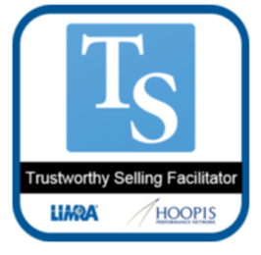
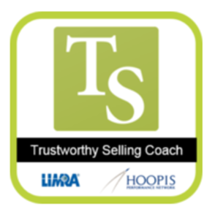
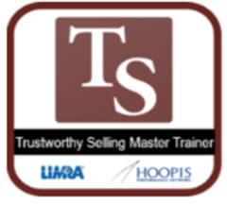
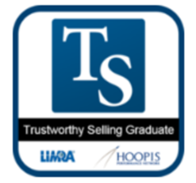
Recognizing Our Participants
Digital Badges are here!
Notes:
Outside of great results, one of our projects for 2021 into 2022 was to get our digital badge system up and running so participants can be recognized for their commitment to completing this program. We issue badges for all program completions to the following groups – certified facilitator, certified coach, certified master trainer, and tsprogram graduate.

Slide 51

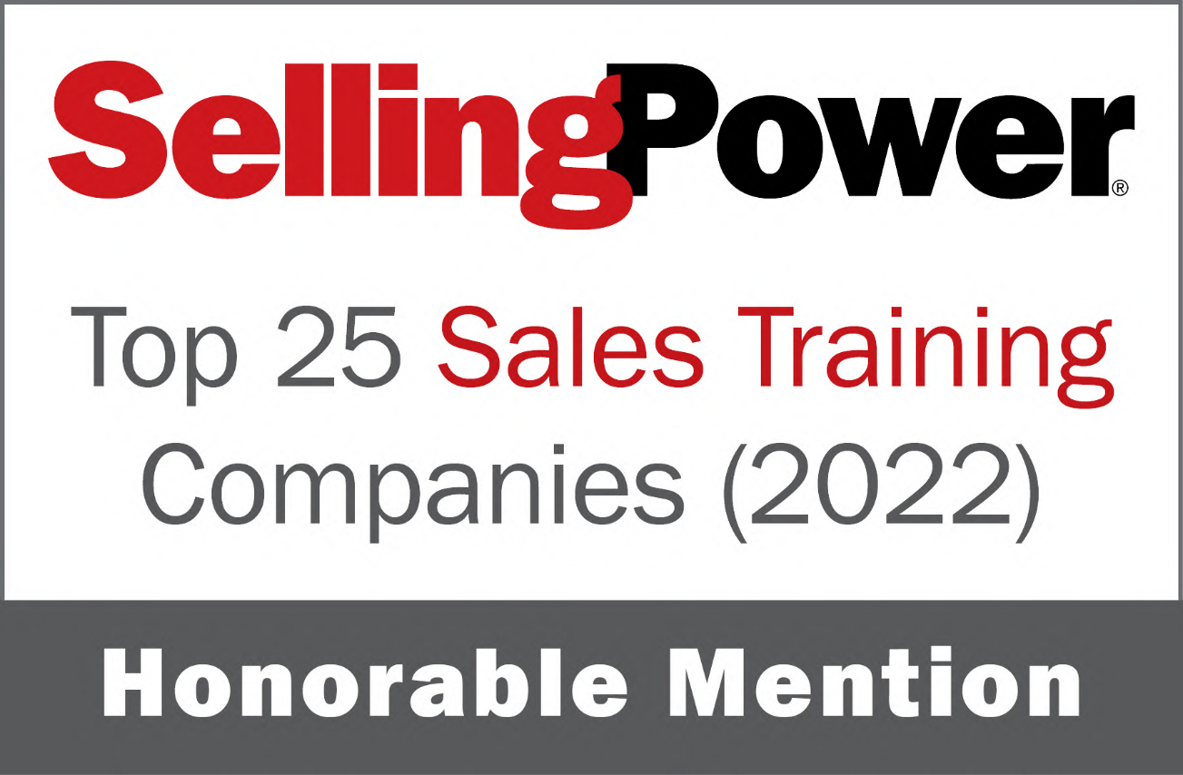


Notes:
We have something to boast about!
For the fourth year in a row, we have been mentioned by Selling Power magazine as one of the top 25 sales training companies in North America!

Slide 52


The best time to plant a tree was a decade ago.
The second best time is now.
| 2.0
Notes:
IMAGINE if you would
Having a more powerful, loyal, and productive distribution.
Empowering your distribution to work smarter and connect more meaningfully with their clients
Having lasting relationships with clients and bridging the consumer trust gap.
Thank you for your time.

